Slide 1
PROJECT – STOCK MARKET DATA ANALYSIS
GROUP – 3 karthik
Manichandana Jillepalli
Jagdish madwani
Mayur Shinde
Arti Sharma
Deeban VM

Slide 2
Business Objective:
In today’s world companies and businesses are very keen to understand and analyze the market to lower their expenses and enhance profits.
With modern data analytics, we can identify purchasing and selling patterns by carefully analyzing the data to help the investors.

Slide 3
Stock Market Analysis is a method in which the investors and traders make buying and selling decisions by studying and analyzing data history and present data. It allows the investors to understand the security that a stock can provide, before investing in it. There are stock analysts who perform thorough research to find out any activity at any sector of the stock market.
By using stock market analysis, investors and traders can reach buying and selling decisions faster. There are two types of Stock Analysis: Fundamental Analysis and Technical Analysis.

Slide 4



Companies we choose to do Stock Market Analysis are :

Slide 5
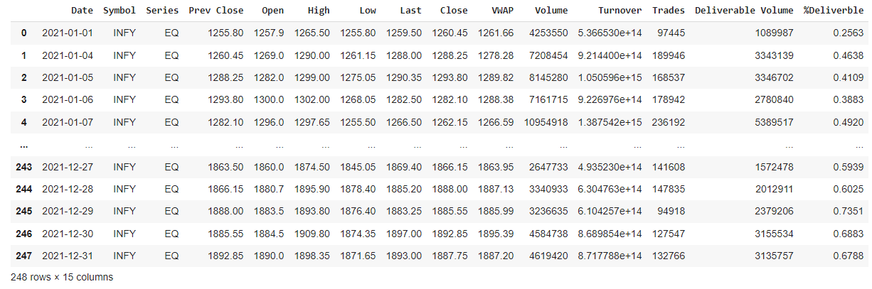
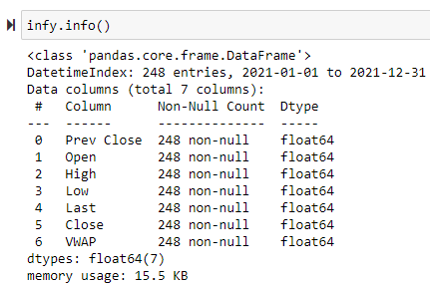
INFOSYS DATA
The original dataset had 15 columns we removed 8 columns most of them had high correlation value compared to others and 2 of them where characteristic data

Slide 6
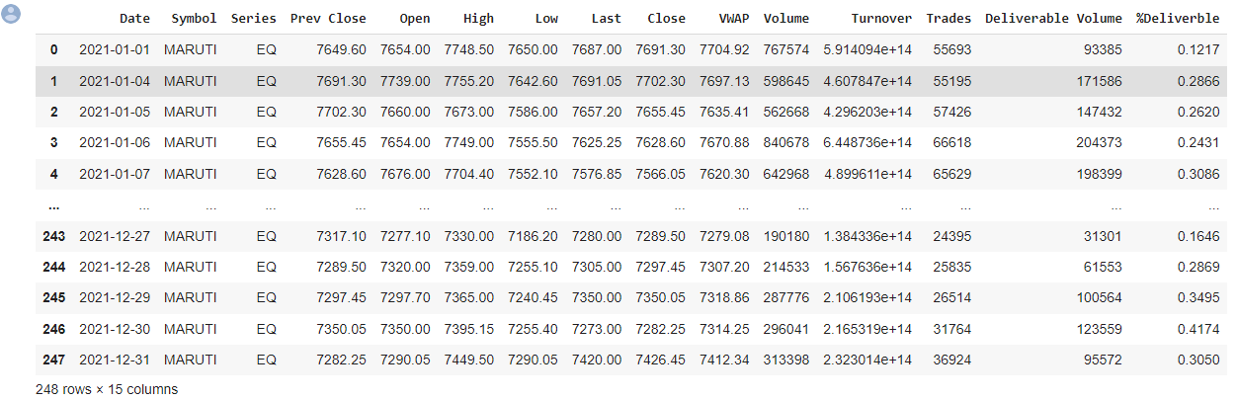
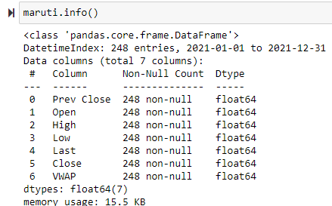
MARUTI DATA

Slide 7
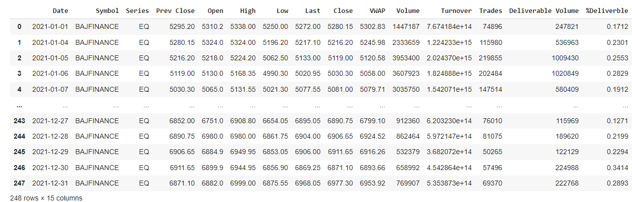
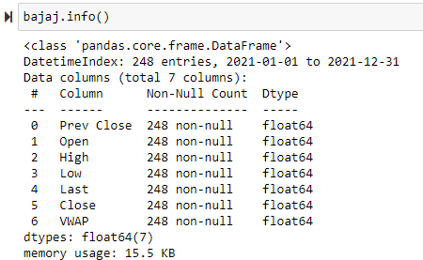
BAJAJ DATA

Slide 8
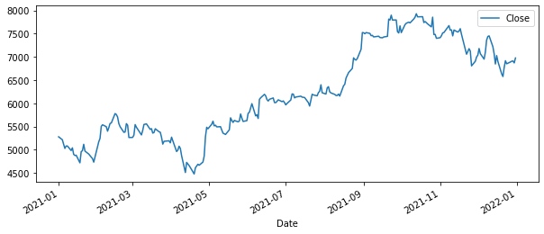
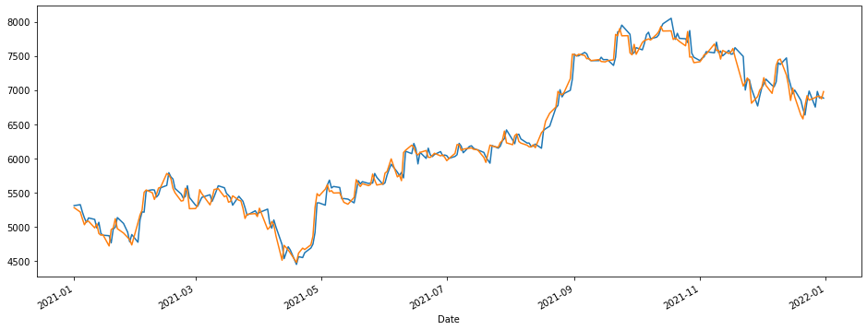
Bajaj Closing value
Comparing Opening and Closing values

Slide 9
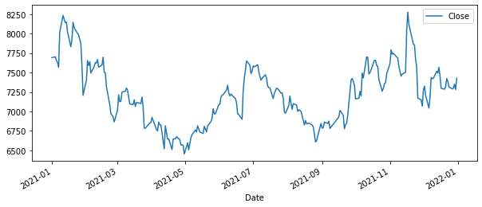
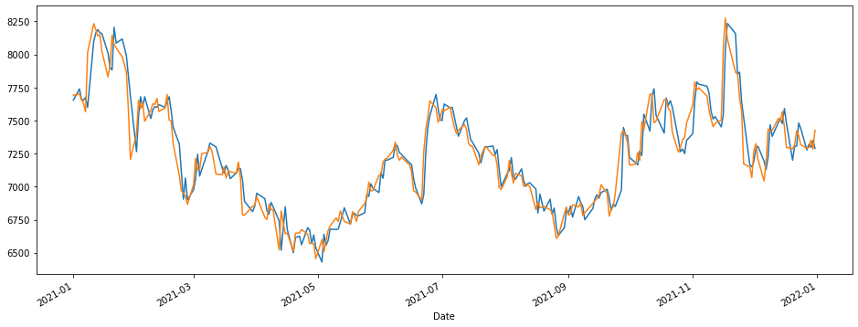
Maruti Closing values
Comparing Opening and Closing values

Slide 10
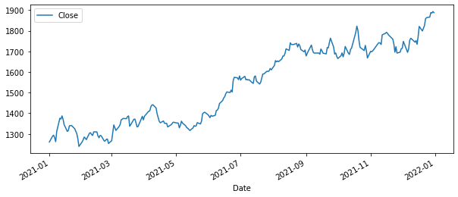
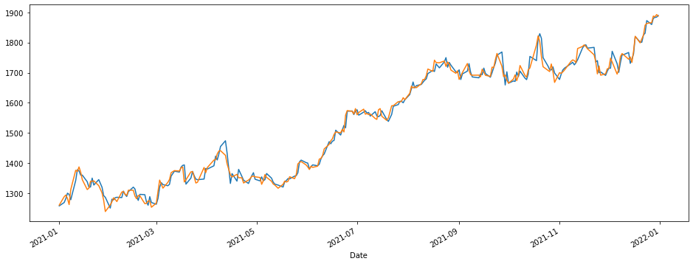
Comparing Opening and Closing values
Infosys Closing data

Slide 11
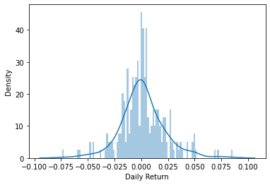
daily returns of Bajaj stocks

Slide 12
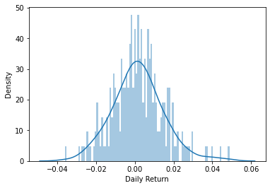
daily returns of infosys stocks

Slide 13
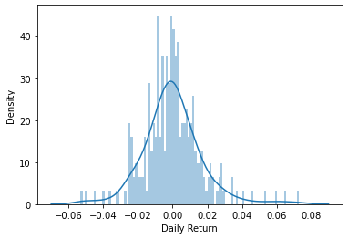
daily returns of Maruti stocks

Slide 14
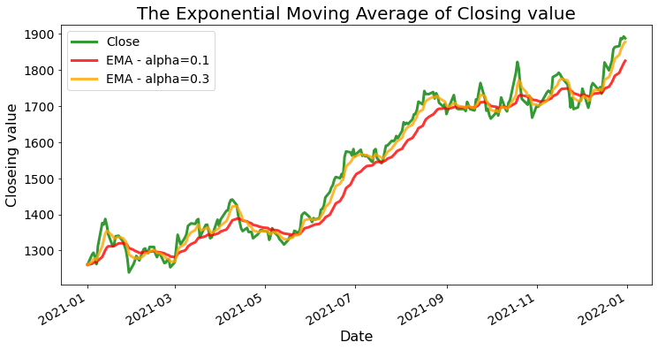
Infosys

Slide 15
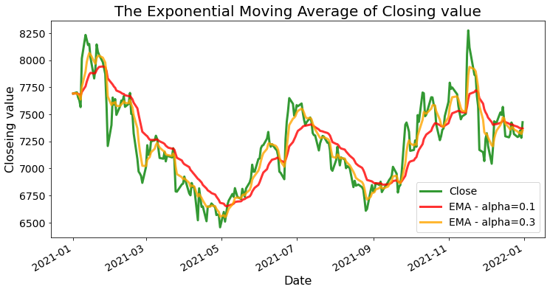
Maruti

Slide 16
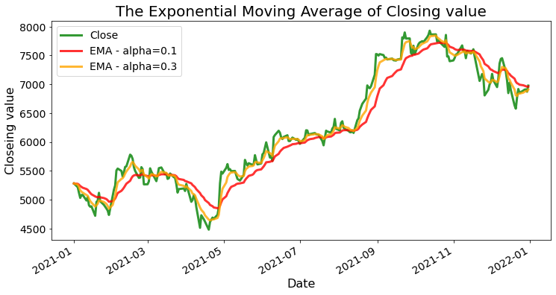
Bajaj

Slide 17

Model results presentation
Model - LSTM
Accuracy: 86%

Slide 18
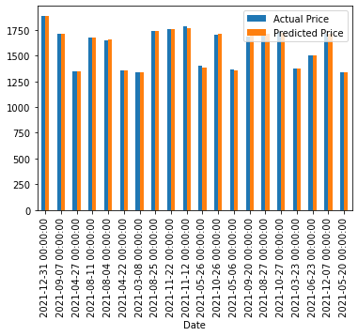
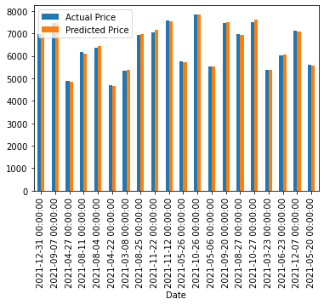

Model results presentation
Model - Linear Regression
Accuracy: 99.7%

Slide 19
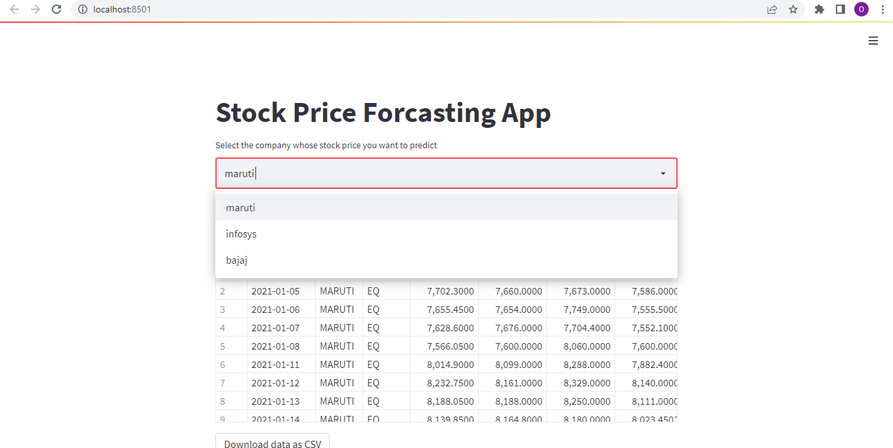
Deployment
Link :- http://localhost:8501/

Slide 20
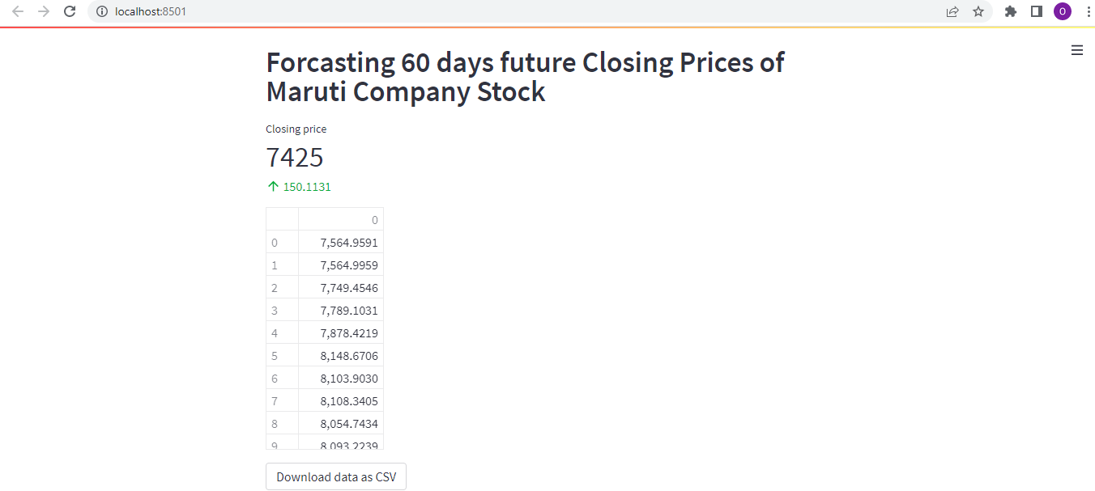
Forecasted values in Deployment

Slide 21
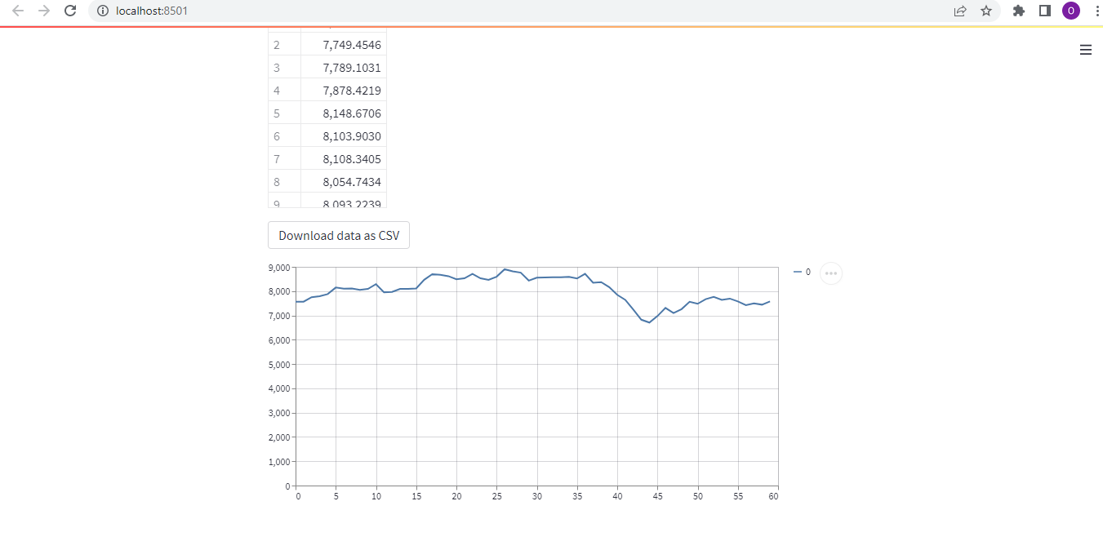
Forecasted values in Deployment

